Slide 1
Chapter 07: Pseudorandom Number Generation and Stream Cipher
Freshman Seminar
2022.01.18
Sumin Sohn

Slide 2
Contents
7.1 Principles of Pseudorandom Number Generation
7.2 Pseudorandom Number Generators
7.3 Pseudorandom Number generation Using a Block Cipher
7.4 Stream Ciphers
7.5 RC4

Slide 3
7.1 Principles of Pseudorandom Number Generation

Slide 4
The Use of Random Numbers
Number of network security algorithms and protocols based on cryptography make use of random binary numbers
Examples
Key distribution
Nonce
Session key
Generation of keys for the RSA public-key encryption algorithm
Generation of a bit steam for symmetric stream encryption

Slide 5
Requirements of Random Numbers
Randomness
Uniform distribution
Distribution of bits in the sequence should be uniform
Frequency of occurrence of ones and zeros should be approximately equal
Independence
No one subsequence in the sequence can be inferred from the others
Unpredictability
Successive member of the sequence should be unpredictable
Each number is statistically independent of other numbers in the sequence

Slide 6
Pseudorandom
Generated by algorithms
Algorithms are deterministic, producing sequence that are not statistically random
With good algorithm, such sequence may look random passing several tests of randomness

Slide 7
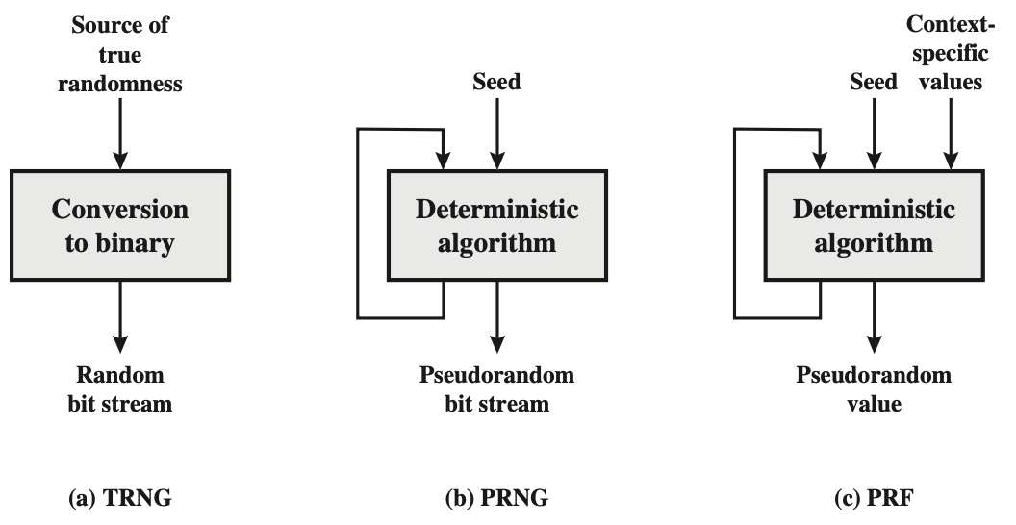
TRNG, PRNG, PRF #1
TRNG(True random number generator)
Uses input source that is effectively random
Timing patterns, disk electrical activity, etc
May involve additional processing to overcome bias of the source
PRNG(Pseudorandom number generator)
Takes seed as input
Produces sequence of output bits using deterministic algorithm
Results of the algorithm are fed back
Produce an open-ended sequence of bits
Adversary who knows the algorithm and seed can reproduce the entire bit stream

Slide 8
TRNG, PRNG, PRF #2
PRF(Pseudorandom function)
Takes seed and context specific values
User ID, application ID
Produces sequence of output bits using deterministic algorithm
Results of the algorithm are fed back
Produce a pseudorandom string of bits of some fixed length

Slide 9
PRNG Requirements
Basic requirement
Adversary who does not know the seed should be unable to determine the pseudorandom string
Specific requirement
Randomness
Unpredictability
Seed requirements

Slide 10
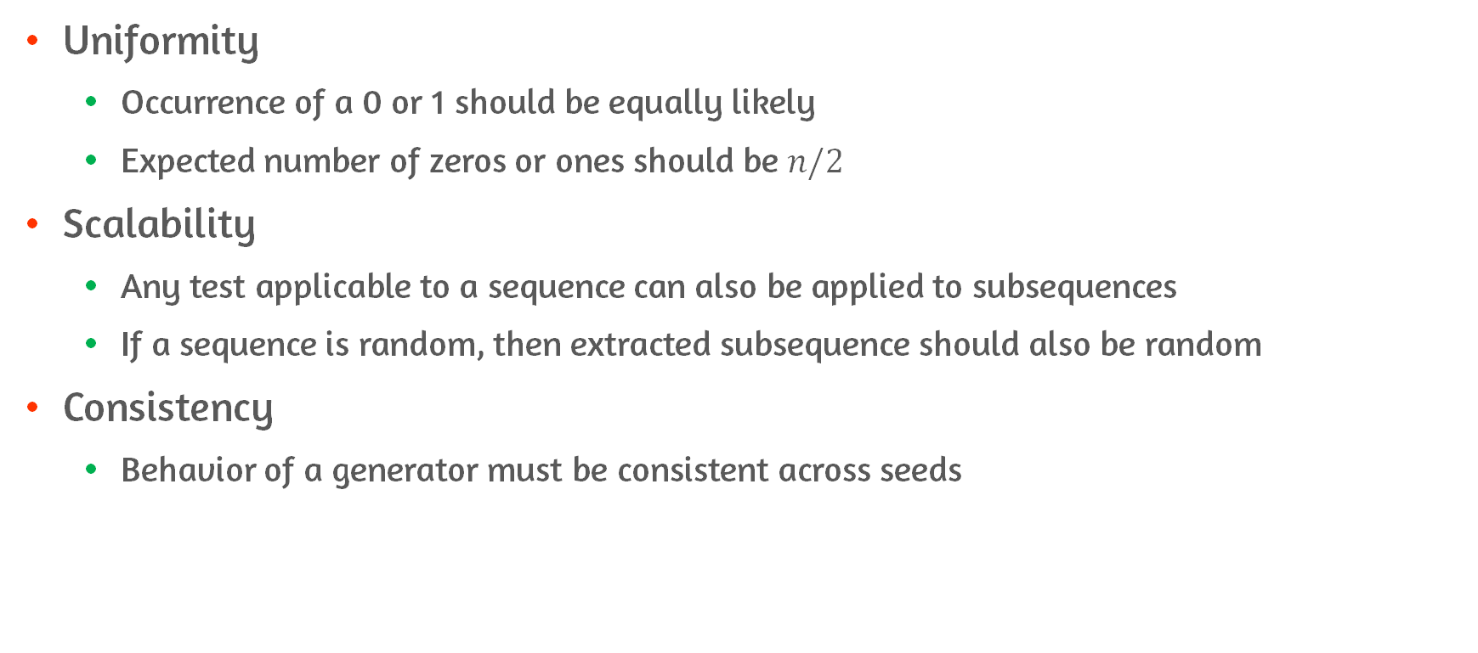
Characteristics of Randomness
Uniformity
Occurrence of a 0 or 1 should be equally likely
Expected number of zeros or ones should be $n/2$
Scalability
Any test applicable to a sequence can also be applied to subsequences
If a sequence is random, then extracted subsequence should also be random
Consistency
Behavior of a generator must be consistent across seeds

Slide 11
Tests for Randomness
Frequency test
Checks if number of ones and zeros in a sequence is approximately the same
Runs test
Total number runs in the sequence
Runs is an uninterrupted sequence of identical bit 00000/11111
Determine whether the number of runs of ones and zeros of various lengths is as expected for a random sequence
Maurer’s universal statistical test
Checks for number of bits between matching patterns
Detect whether or not the sequence can be significantly compressed without loss of information

Slide 12
2 Forms of Unpredictability
Forward unpredictability
If the seed in unknown, the next output bit in the sequence should be unpredictable in spite of any knowledge of previous bits
Backward unpredictability
It should not be feasible to determine the seed from knowledge of any generated values
No correlation between seed and any value generated from that seed should be evident

Slide 13
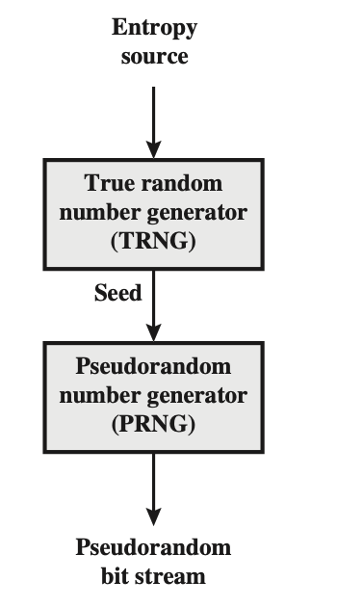
Seed Requirements
Seed that serves as input to PRNG must be secure and unpredictable
PRNG is deterministic algorithm, therefore same seed generates same sequence
Typically, seed is generated by TRNG

Slide 14
PRNG Algorithm Design
Purpose-built algorithms
Algorithms designed specifically and solely for the purpose of generating pseudorandom bit streams
Algorithms based on existing cryptographic algorithms
Since existing cryptographic algorithms provide randomizing input data, they can serve as the core of PRNG algorithm
Cryptographic algorithms commonly used to create PRNGs
Symmetric block ciphers
Asymmetric ciphers
Hash functions and message authentication codes

Slide 15
7.2 Pseudorandom Number Generators

Slide 16
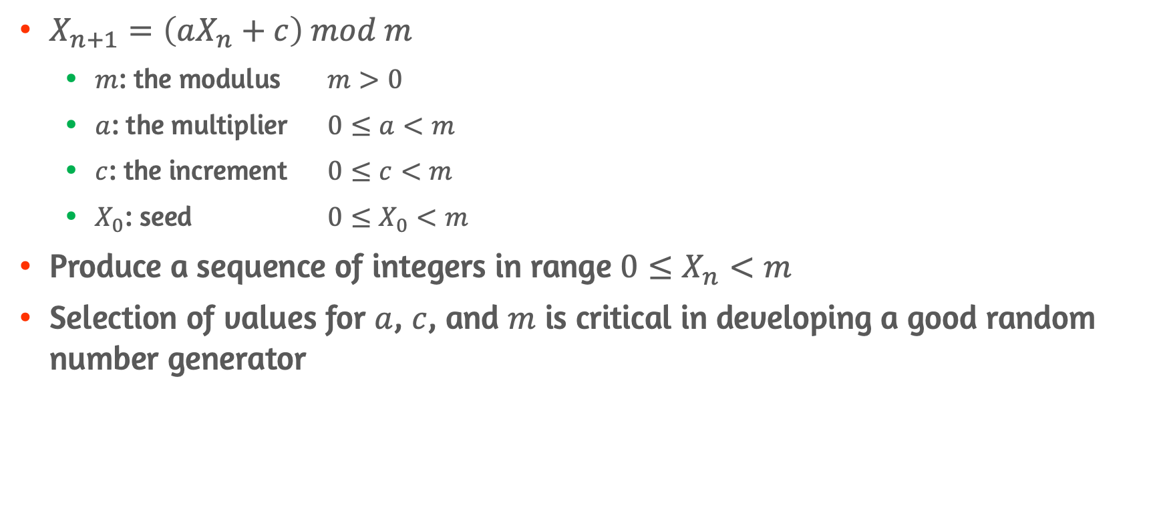
Linear Congruential Generators
$X_{n+1}=\left(aX_{n}+c\right) mod m$
$m$: the modulus $m>0$
$a$: the multiplier $0≤a<m$
$c$: the increment $0≤c<m$
$X_{0}$: seed $0≤X_{0}<m$
Produce a sequence of integers in range $0≤X_{n}<m$
Selection of values for $a$, $c$, and $m$ is critical in developing a good random number generator

Slide 17
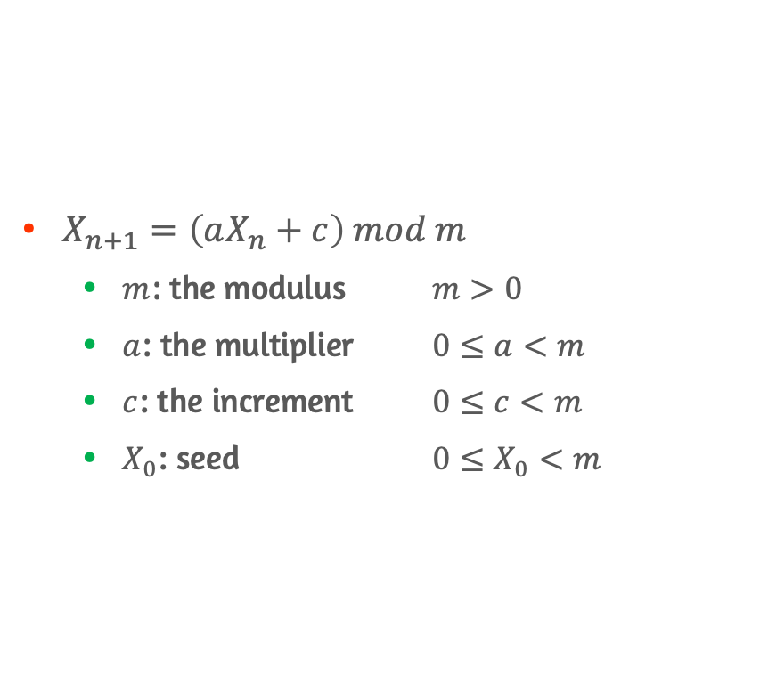
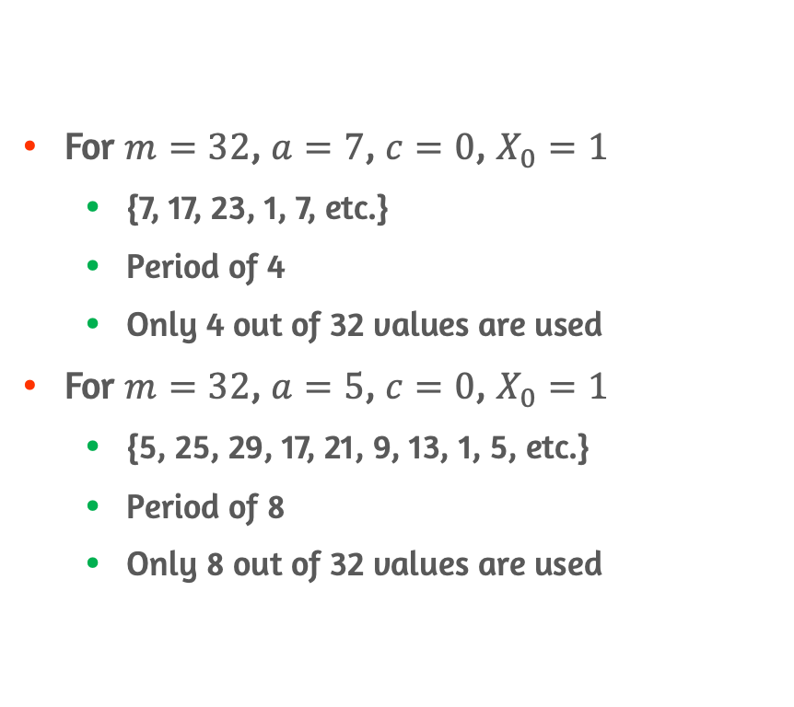
Example of LCG
For $m=32$, $a=7$, $c=0$, $X_{0}=1$
{7, 17, 23, 1, 7, etc.}
Period of 4
Only 4 out of 32 values are used
For $m=32$, $a=5$, $c=0$, $X_{0}=1$
{5, 25, 29, 17, 21, 9, 13, 1, 5, etc.}
Period of 8
Only 8 out of 32 values are used
$X_{n+1}=\left(aX_{n}+c\right) mod m$
$m$: the modulus $m>0$
$a$: the multiplier $0≤a<m$
$c$: the increment $0≤c<m$
$X_{0}$: seed $0≤X_{0}<m$

Slide 18
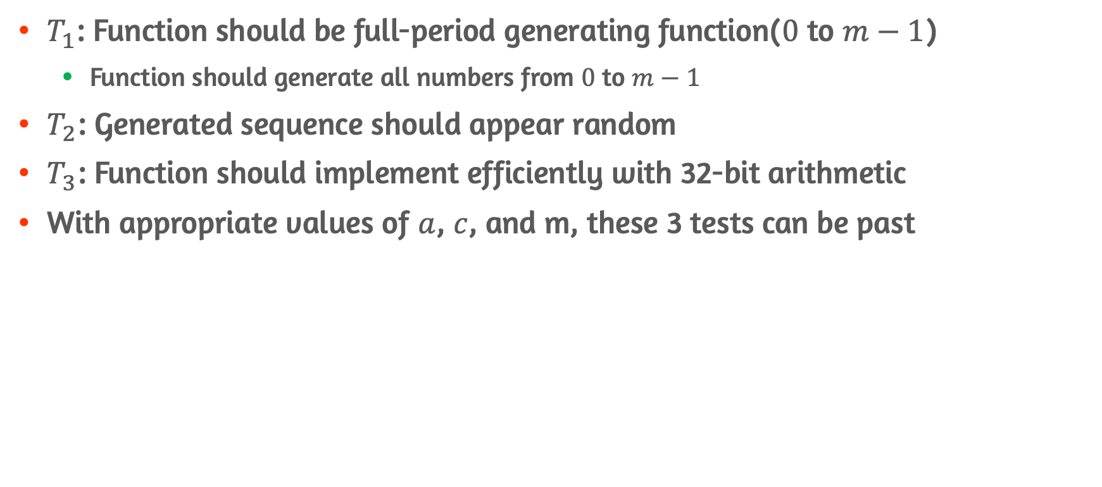
Tests to evaluate LCG
$T_{1}$: Function should be full-period generating function($0$ to $m−1$)
Function should generate all numbers from $0$ to $m−1$
$T_{2}$: Generated sequence should appear random
$T_{3}$: Function should implement efficiently with 32-bit arithmetic
With appropriate values of $a$, $c$, and m, these 3 tests can be past

Slide 19
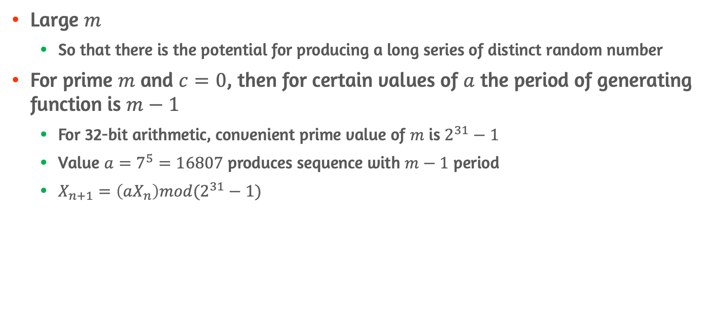

Appropriate Values of $a$, $c$, and $m$
Large $m$
So that there is the potential for producing a long series of distinct random number
For prime $m$ and $c=0$, then for certain values of $a$ the period of generating function is $m−1$
For 32-bit arithmetic, convenient prime value of $m$ is $2^{31}−1$
Value $a=7^{5}=16807$ produces sequence with $m−1$ period
$X_{n+1}=\left(aX_{n}\right)mod(2^{31}−1)$

Slide 20
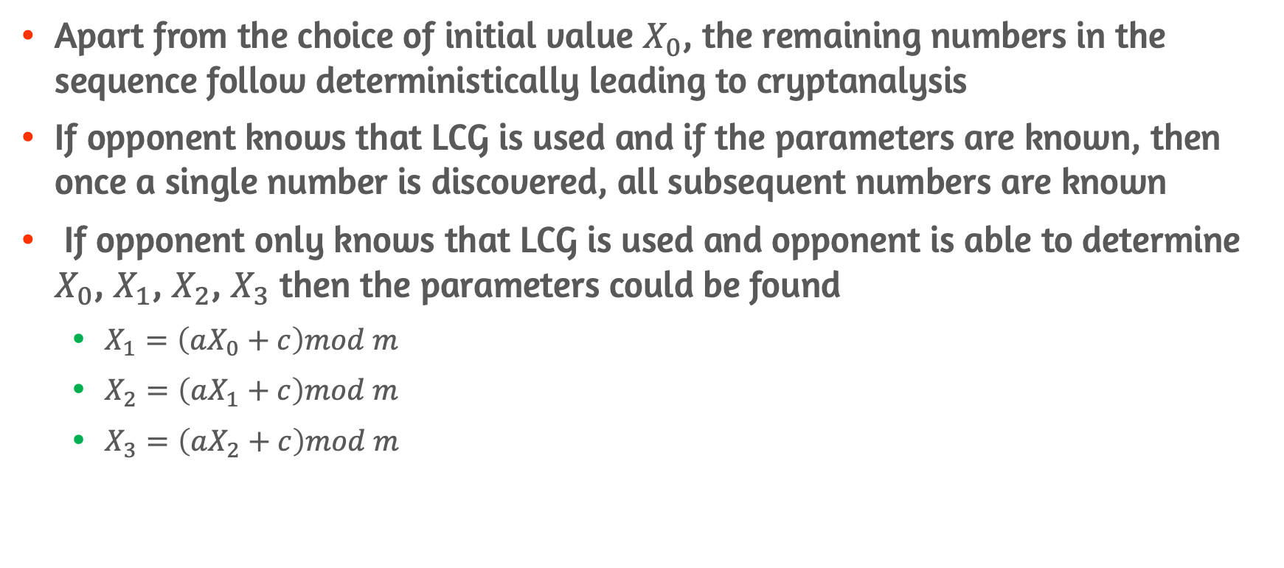
Weakness of LCG
Apart from the choice of initial value $X_{0}$, the remaining numbers in the sequence follow deterministically leading to cryptanalysis
If opponent knows that LCG is used and if the parameters are known, then once a single number is discovered, all subsequent numbers are known
If opponent only knows that LCG is used and opponent is able to determine $X_{0}$, $X_{1}$, $X_{2}$, $X_{3}$ then the parameters could be found
$X_{1}=\left(aX_{0}+c\right)mod m$
$X_{2}=\left(aX_{1}+c\right)mod m$
$X_{3}=\left(aX_{2}+c\right)mod m$

Slide 21
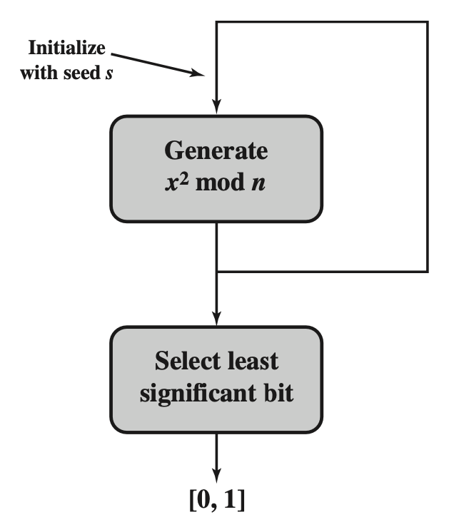
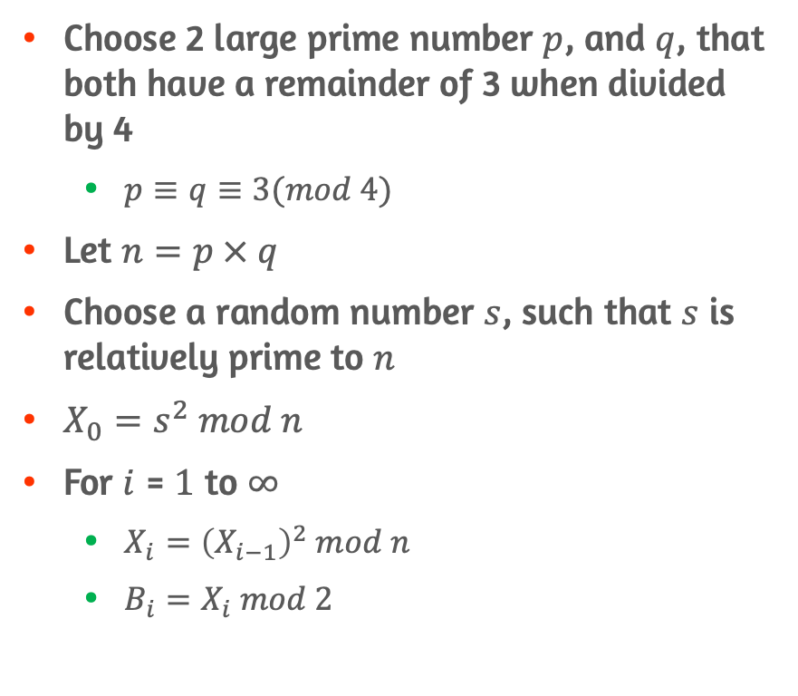
Blum Blum Shub Generator
Choose 2 large prime number $p$, and $q$, that both have a remainder of 3 when divided by 4
$p≡q≡3(mod 4)$
Let $n=p × q$
Choose a random number $s$, such that $s$ is relatively prime to $n$
$X_{0}=s^{2} mod n$
For $i$ = $1$ to $∞$
$X_{i}={\left(X_{i−1}\right)}^{2} mod n$
$B_{i}=X_{i} mod 2$

Slide 22
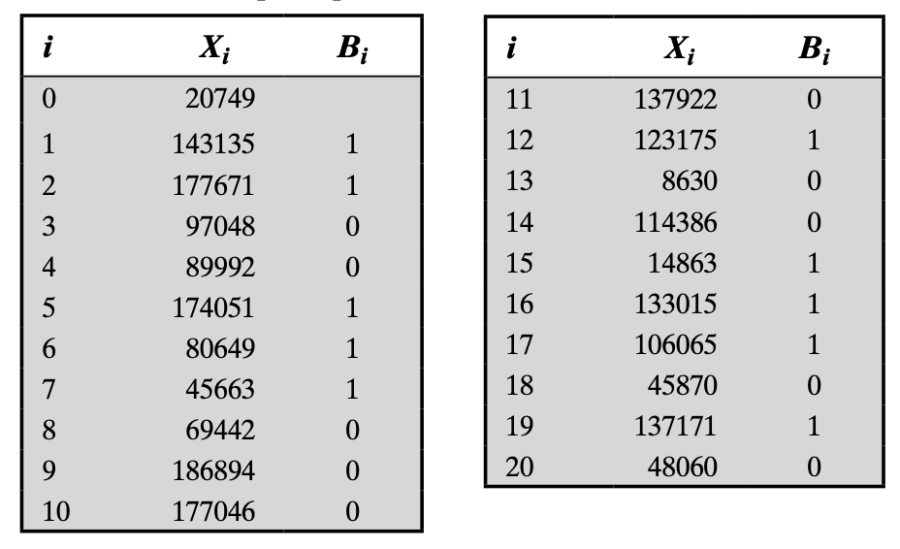
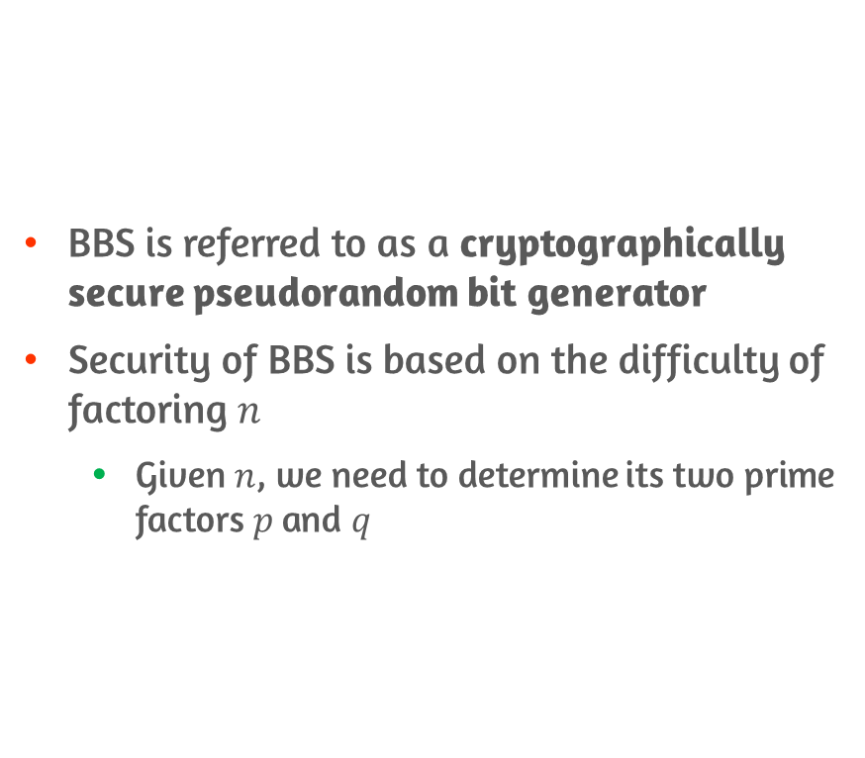
Characteristics of BBS
BBS is referred to as a cryptographically secure pseudorandom bit generator
Security of BBS is based on the difficulty of factoring $n$
Given $n$, we need to determine its two prime factors $p$ and $q$

Slide 23
7.3 Pseudorandom Number generation Using a Block Cipher

Slide 24
PRNG Using Symmetric Block Cipher
Popular approach to PRNG construction is to use symmetric block cipher
Symmetric block cipher produces an output block that is apparently random
No patterns or regularities in the cipher text that provide information that can be used to deduce the plaintext

Slide 25
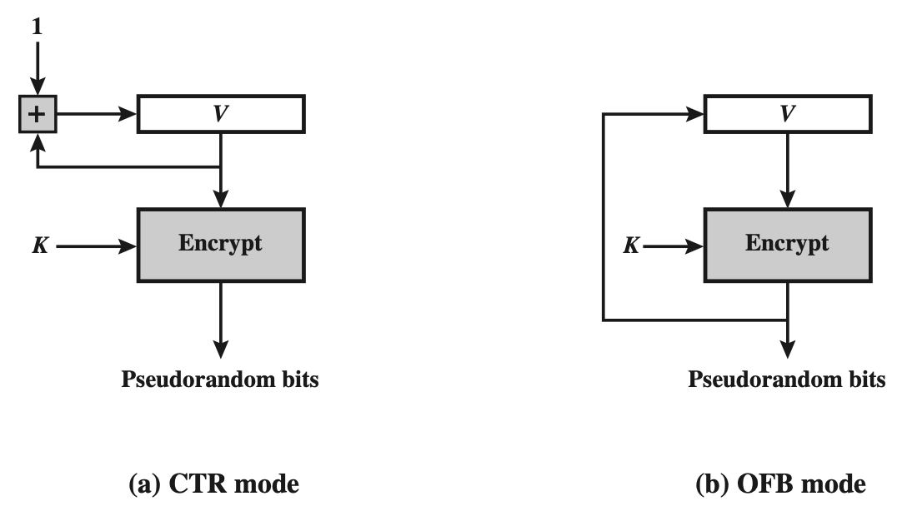
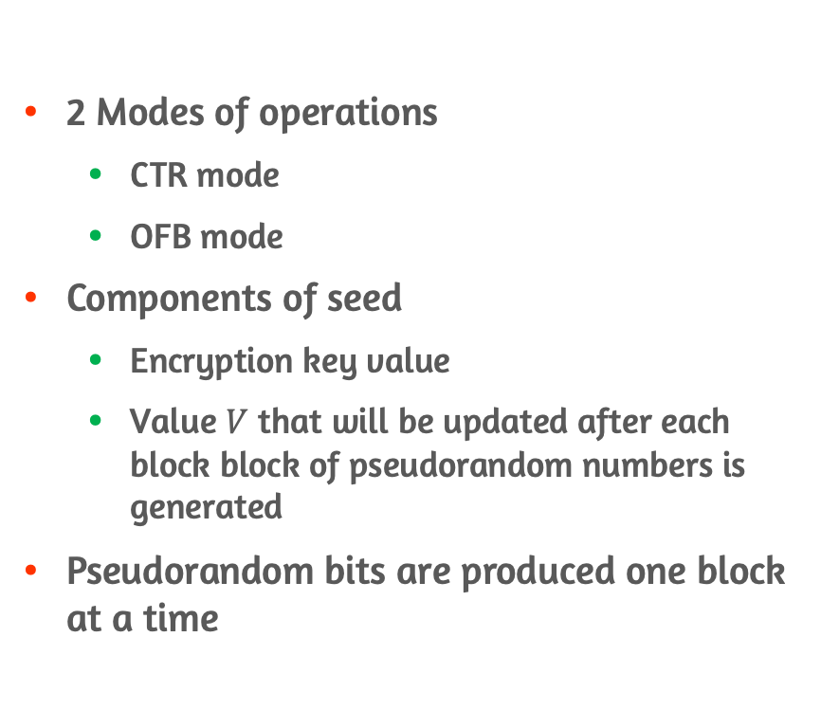
PRNG Using Block Cipher Modes of Operations
2 Modes of operations
CTR mode
OFB mode
Components of seed
Encryption key value
Value $V$ that will be updated after each block block of pseudorandom numbers is generated
Pseudorandom bits are produced one block at a time

Slide 26
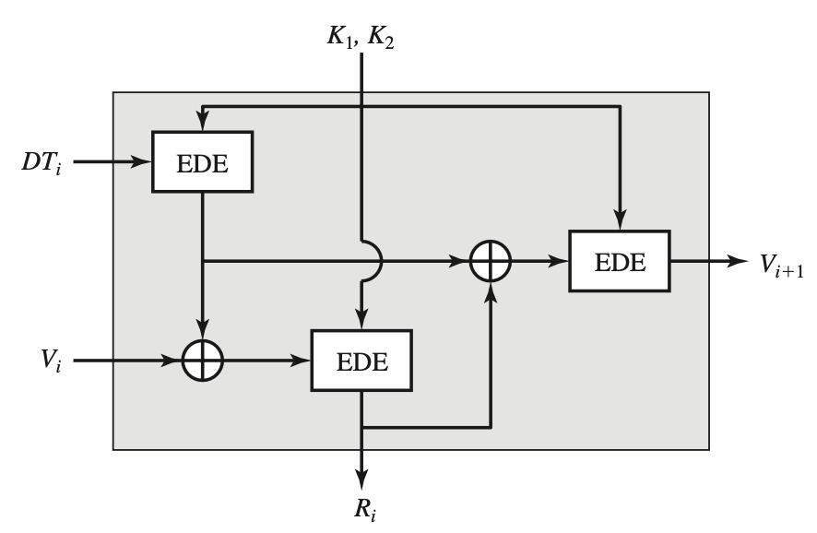
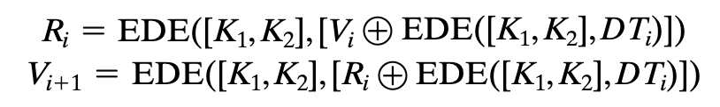
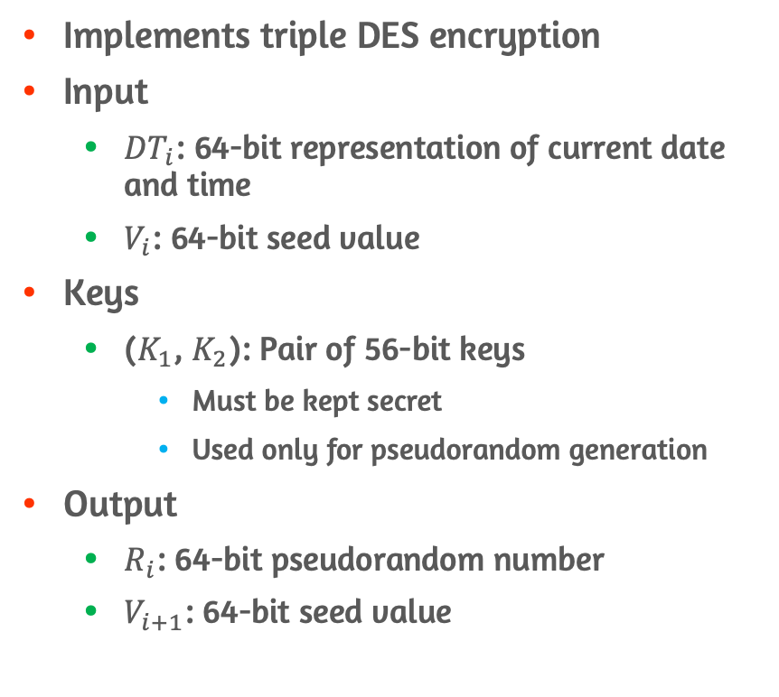
ANSI X9.17 PRNG
Implements triple DES encryption
Input
${DT}_{i}$: 64-bit representation of current date and time
$V_{i}$: 64-bit seed value
Keys
($K_{1}$, $K_{2}$): Pair of 56-bit keys
Must be kept secret
Used only for pseudorandom generation
Output
$R_{i}$: 64-bit pseudorandom number
$V_{i+1}$: 64-bit seed value

Slide 27
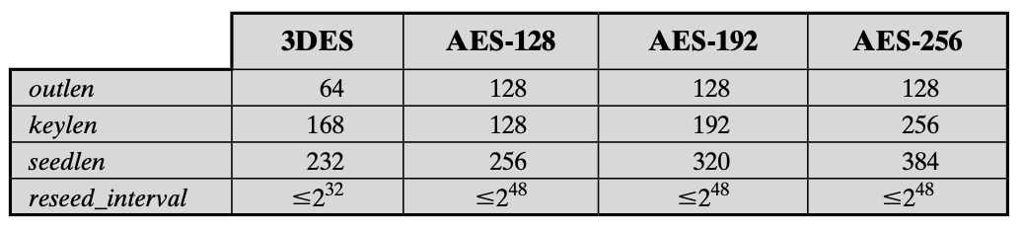
Parameters of DRBG
outlen: output block length
keylen: key length
seedlen: seed length
seedlen = outlen + keylen
reseed_interval: reseed interval
Maximum number of output blocks generated before updating the algorithm with a new seed

Slide 28
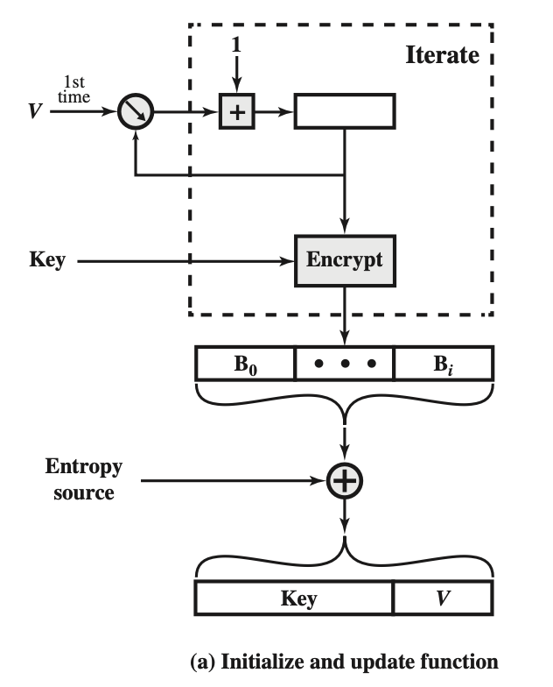
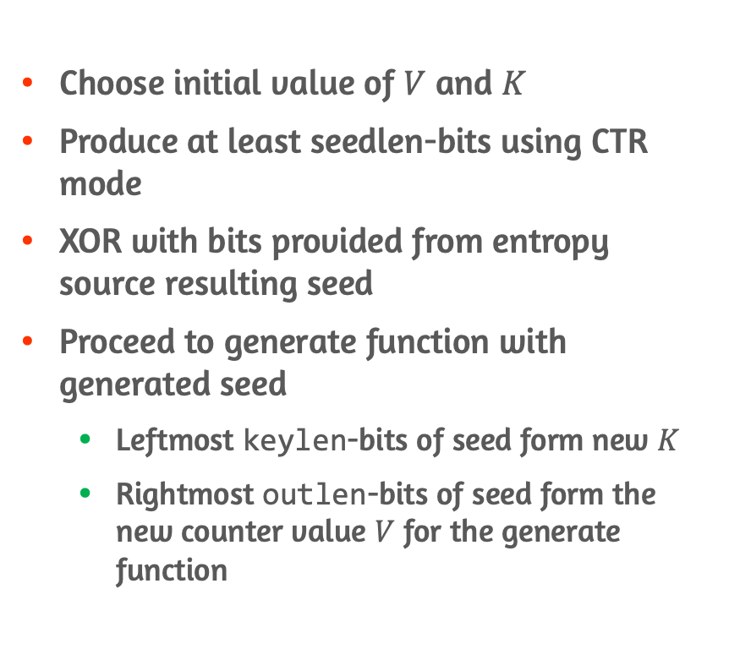
Initialize Stage of DRBG
Choose initial value of $V$ and $K$
Produce at least seedlen-bits using CTR mode
XOR with bits provided from entropy source resulting seed
Proceed to generate function with generated seed
Leftmost keylen-bits of seed form new $K$
Rightmost outlen-bits of seed form the new counter value $V$ for the generate function

Slide 29
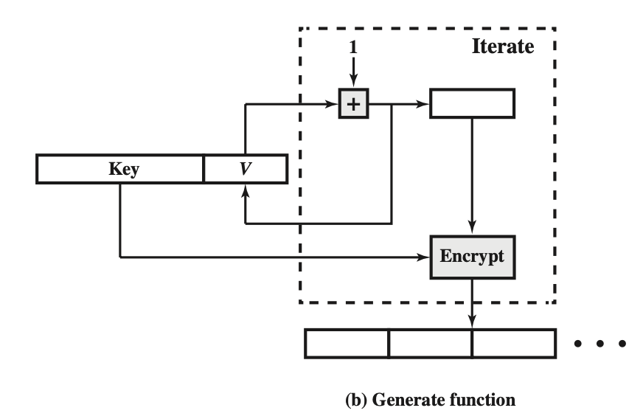
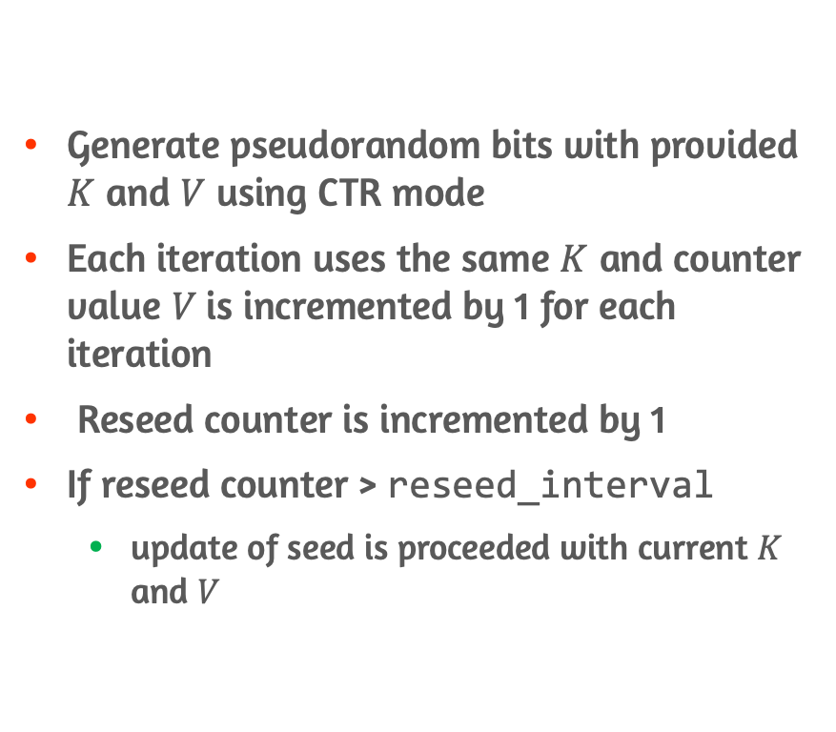
Generate Stage of DRBG
Generate pseudorandom bits with provided $K$ and $V$ using CTR mode
Each iteration uses the same $K$ and counter value $V$is incremented by 1 for each iteration
Reseed counter is incremented by 1
If reseed counter > reseed_interval
update of seed is proceeded with current $K$ and $V$

Slide 30
7.4 Stream Ciphers

Slide 31
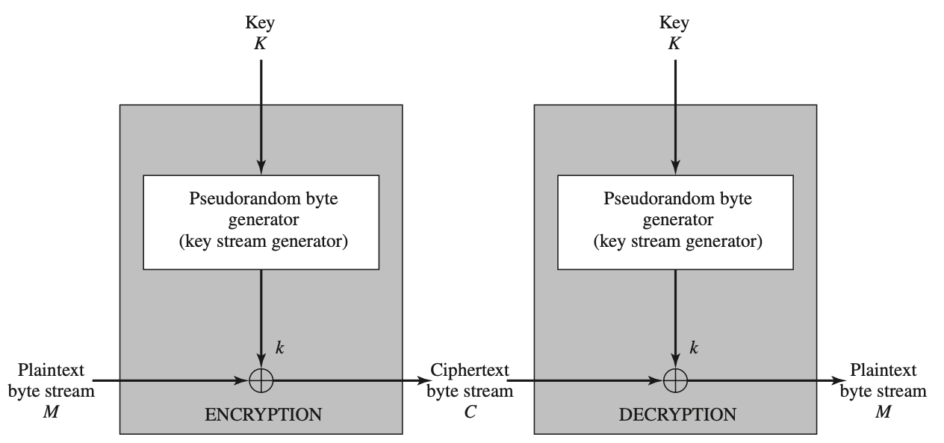
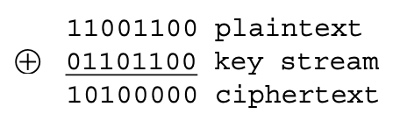
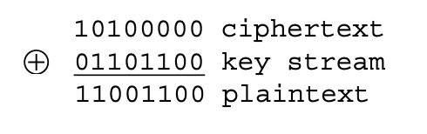
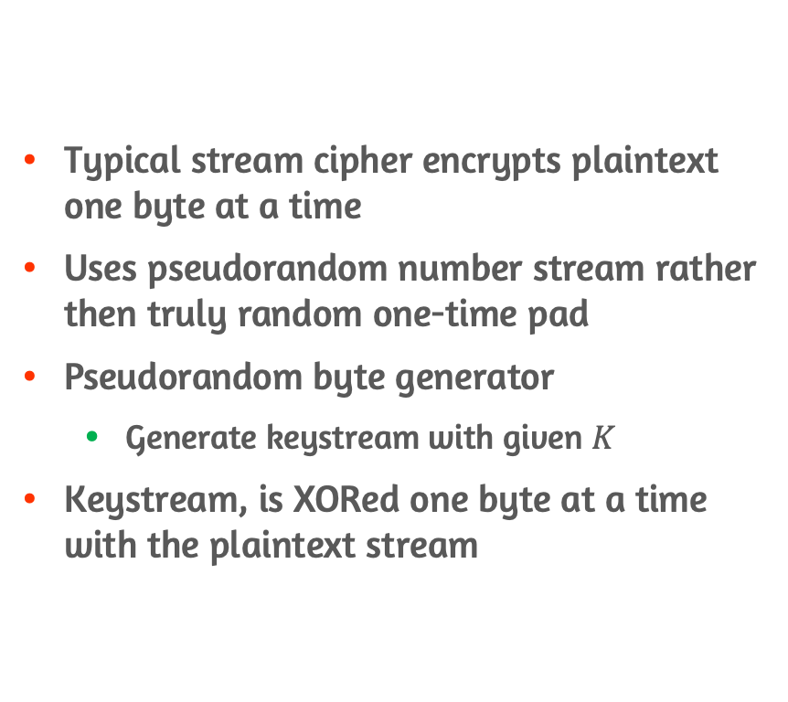
Stream Cipher Structure
Typical stream cipher encrypts plaintext one byte at a time
Uses pseudorandom number stream rather then truly random one-time pad
Pseudorandom byte generator
Generate keystream with given $K$
Keystream, is XORed one byte at a time with the plaintext stream

Slide 32
Design Considerations for Stream Cipher
Encryption sequence should have a large period
PRNG uses a function that produces a deterministic stream of bits that eventually repeats
Keystream should approximate the properties of a true random number stream as close as possible
Approximately equal number of 1s and 0s
To guard against brute-force attacks, the key needs to be sufficiently long

Slide 33
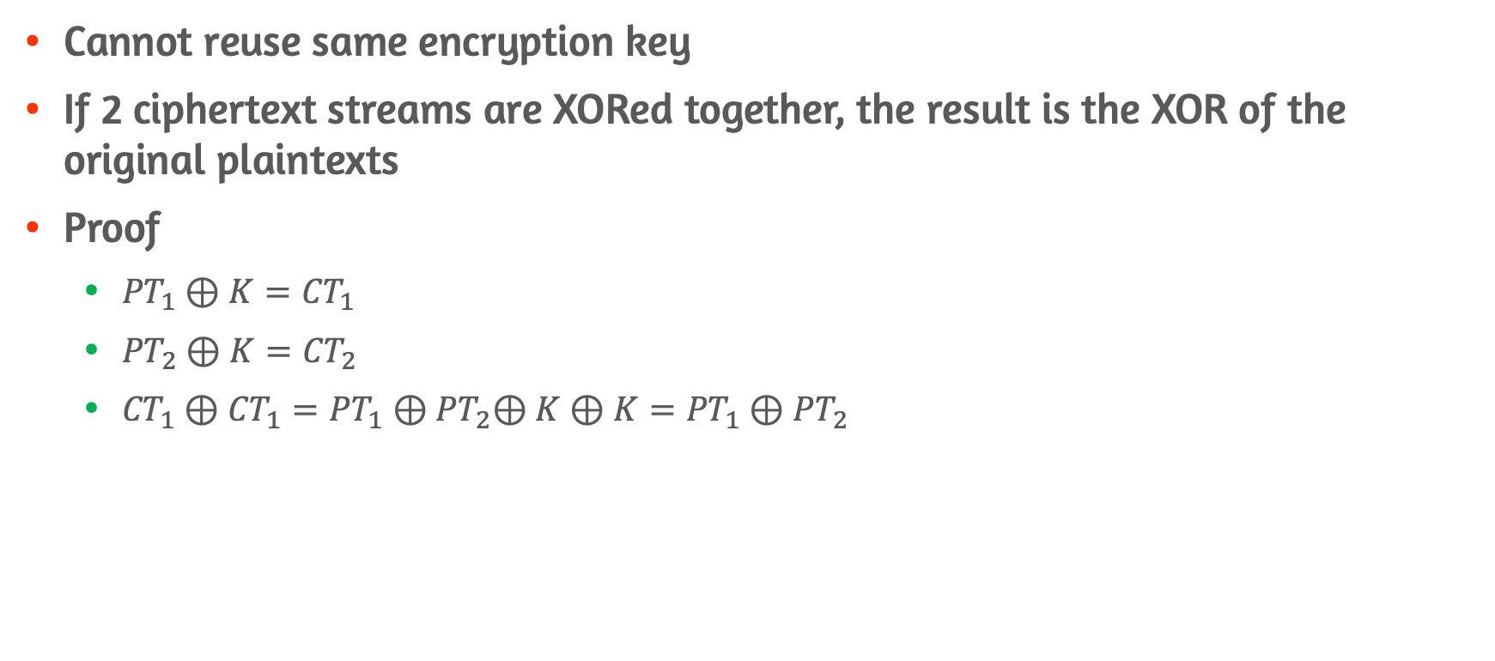
Weakness of Stream Cipher
Cannot reuse same encryption key
If 2 ciphertext streams are XORed together, the result is the XOR of the original plaintexts
Proof
${PT}_{1}⊕K={CT}_{1}$
${PT}_{2}⊕K={CT}_{2}$
${CT}_{1}⊕{CT}_{1}={PT}_{1}{⊕PT}_{2}⊕K⊕K={PT}_{1}{⊕PT}_{2}$

Slide 34
7.5 RC4

Slide 35
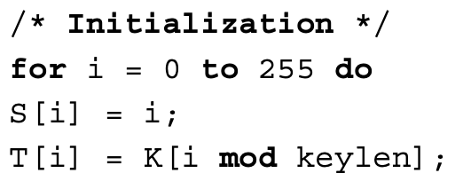
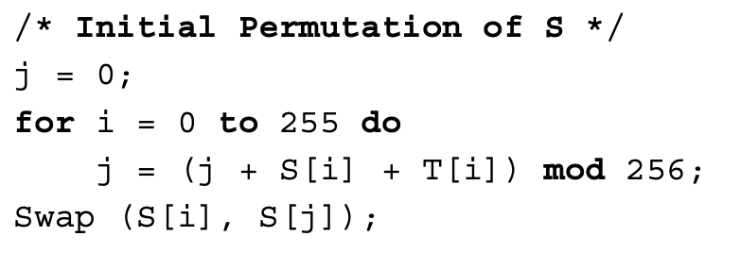
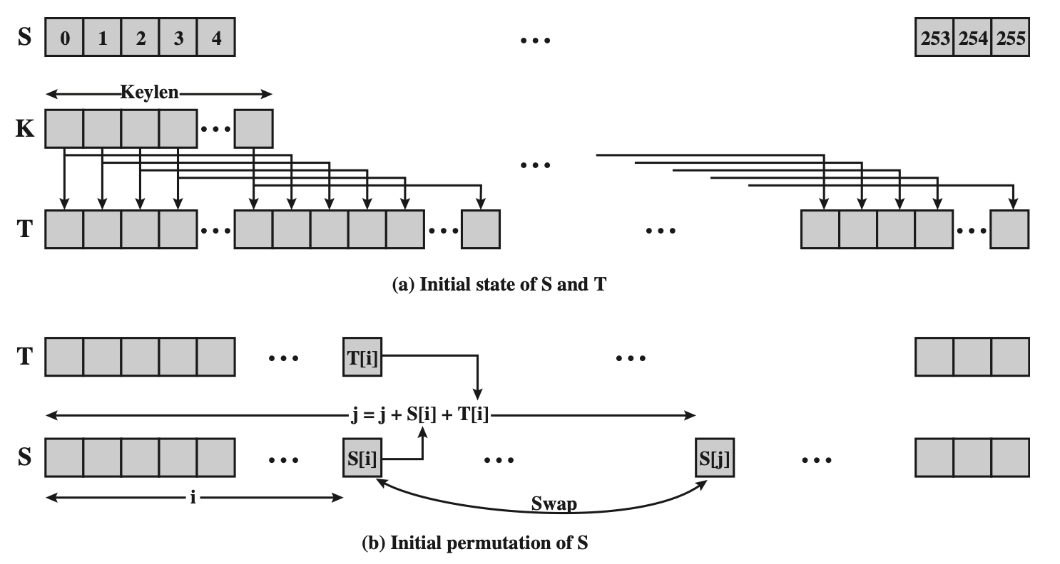
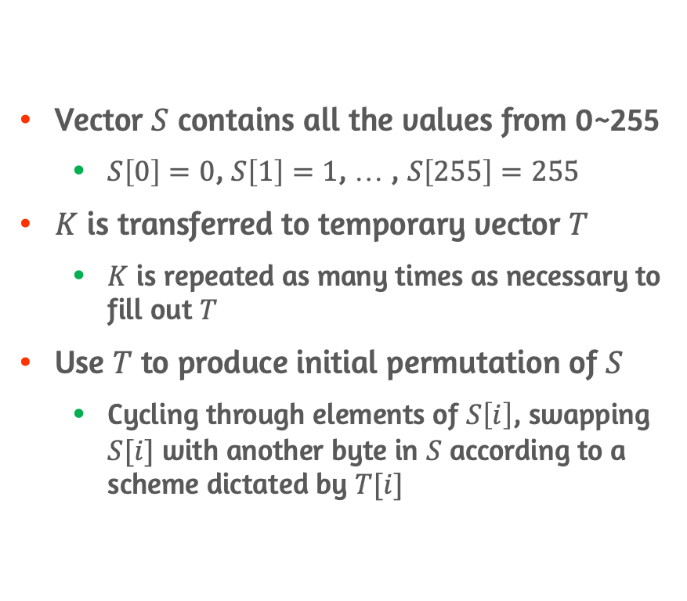

Initialization of $S$
Vector $S$ contains all the values from 0~255
$S\left[0\right]=0$, $S\left[1\right]=1$, … , $S\left[255\right]=255$
$K$ is transferred to temporary vector $T$
$K$ is repeated as many times as necessary to fill out $T$
Use $T$ to produce initial permutation of $S$
Cycling through elements of $S\left[i\right]$, swapping $S[i]$ with another byte in $S$ according to a scheme dictated by $T[i]$

Slide 36
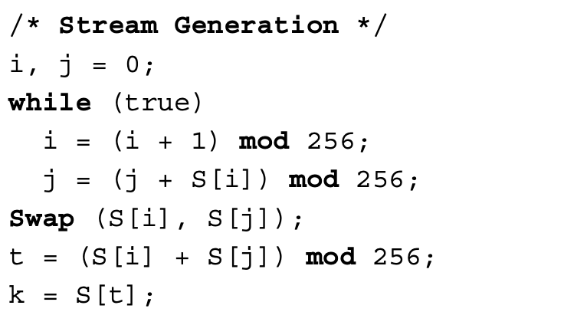
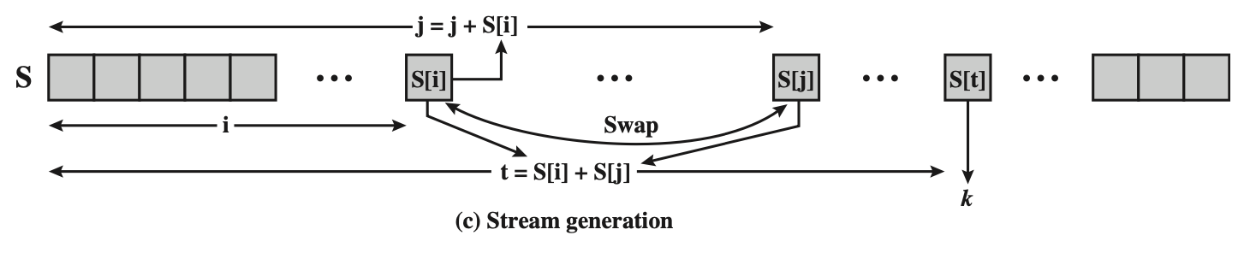
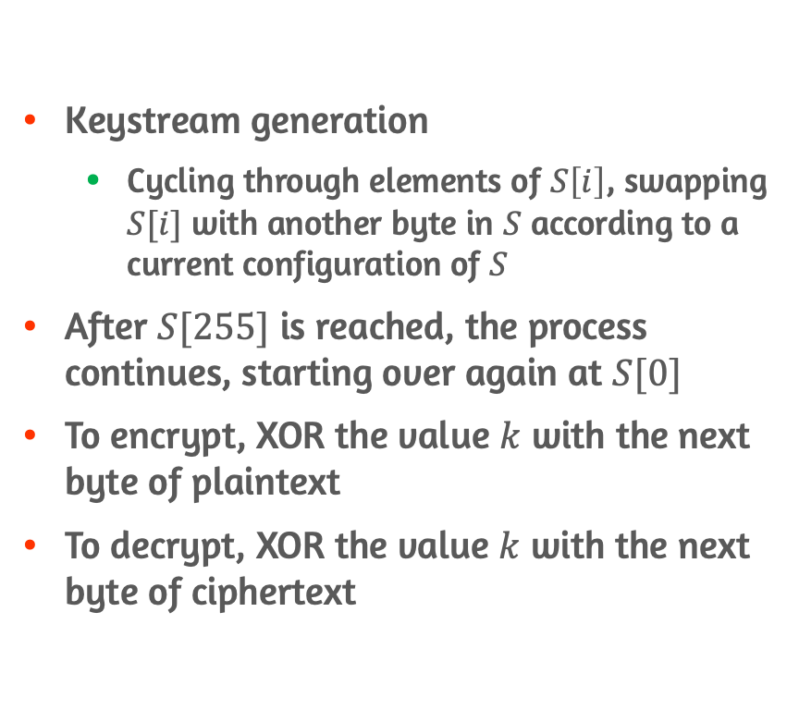
Stream Generation and Enc/Dec
Keystream generation
Cycling through elements of $S\left[i\right]$, swapping $S[i]$ with another byte in $S$ according to a current configuration of $S$
After $S[255]$ is reached, the process continues, starting over again at $S[0]$
To encrypt, XOR the value $k$ with the next byte of plaintext
To decrypt, XOR the value $k$ with the next byte of ciphertext

Slide 37
Conclusion
Concepts of Pseudorandom
Principles of TRNG, PRNG, PRF
PRNG: LCG & BBS
PRNG using block cipher modes of operation
Overview of stream ciphers and RC4

